Slide 1
REAL-TIME WORLD POPULATION monitoring: a sensor driven simulation
STACEY BALTHAZAR NAROCHO

Slide 2
OBJECTIVES
This project aims to simulate a live stream observation of the current human population in the world by country, date and time. It involves leveraging a world population time series dataset from Kaggle to reconstruct and analyze the data in real time. This dataset contains human daily population recordings from the first –tenth of august 2023 . This is a system that utilizes python for data processing, stream queries, and visualization together with SQL for database management. If this data were generated by sensors in real time how would that be represented? . This shows the potential of using sensor technology to in providing accurate and timely updates.

Slide 3
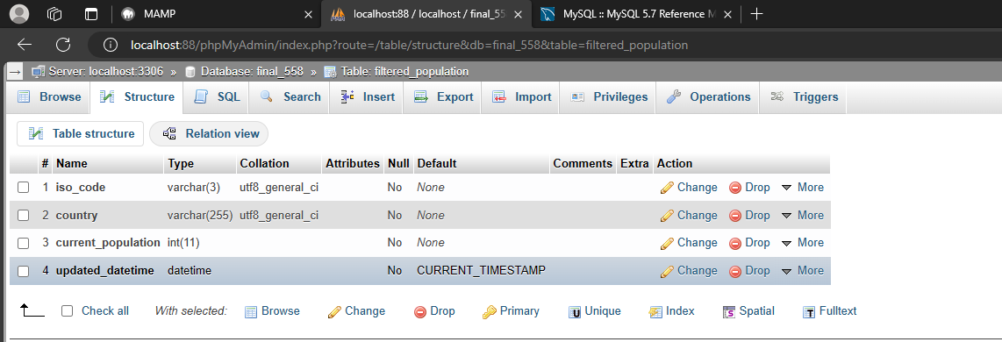
EXECUTION Database used: 2021 population dataset from Kaggle(updated daily to 2023 )-time series _population_count.csv link :https://www.kaggle.com/datasets/rsrishav/world-population
Create a DATABASE (final_558) with mysql:
Use of the database to create a table(filtered_ population) to store the Streamed data.

Slide 4
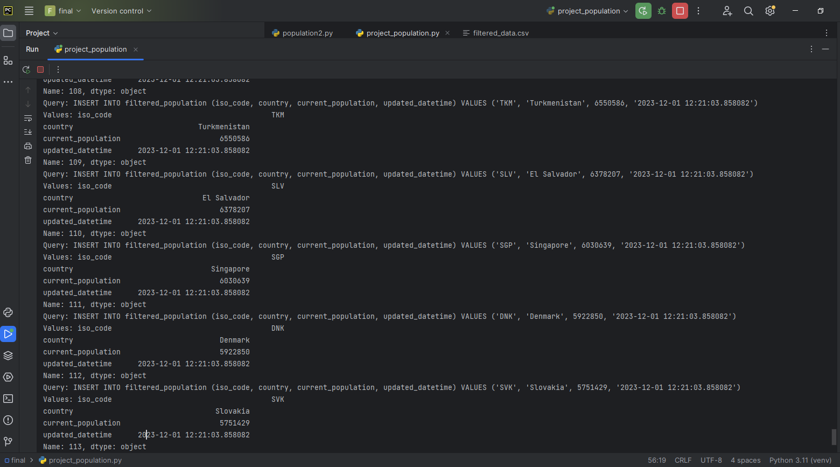
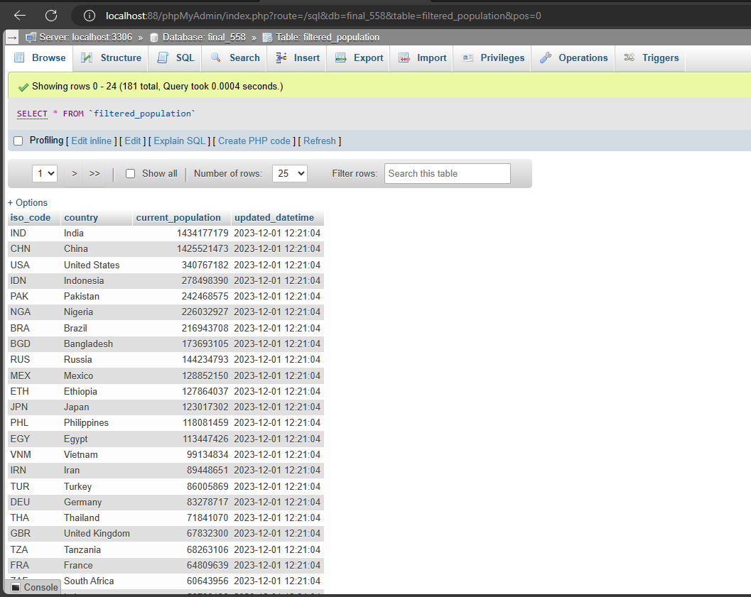
PYTHON SCRIPTING:USED PANDAS PACKAGE TO PREPROCESS THE HUGE AMOUNT OF DATA AND EXTRACT A SAMPLE OF THE DATA TO BE USED IN THIS PROJECT. MAKE THE EXISTING DATASET SIMULATE A LIVE STREAM OF DATA IN A LOOP AND CONTINUOUSLY STORE THE DATA INTO THE MYSQL DATABASE
Representation of the live data
Representation of database

Slide 5
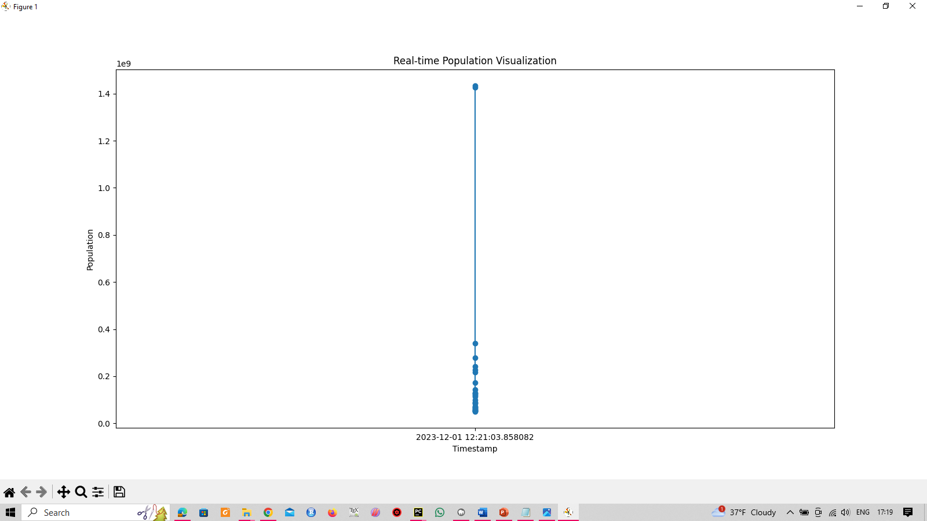
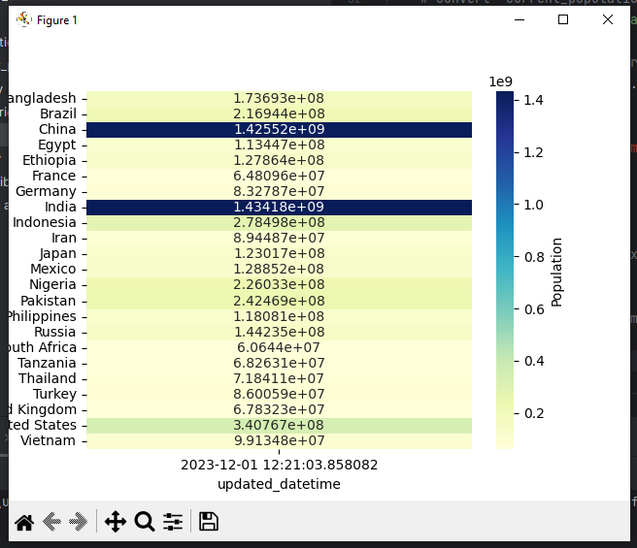
visualizations
Real time population visualization.
Sample of live heatmap simulation –for population changes over time for each country

Slide 6
Live scatter plot of population density by country in this case - Kenya

Slide 7
Data accuracy.
Placement of sensors.
Data quality.
Maintenance.
Data management.
Integration of current technological systems
Use cases for real time human population data streaming.
Predictive Modelling-forecast future trends and patterns.
Sensitivity analysis and uncertainty assessment-Analyze assumptions on simulations.
Computational efficiency-handling huge amounts of data in real time and updating outputs seamlessly.
Spatiotemporal analysis-use sensor data to capture population dynamics such as population changes over time and their spatial distribution.
Geospatial Analysis –integrate population data with factors like infrastructure , land use and transportation.
When selecting a people counting sensor technology the following should be considered:

Slide 8
Key Takeaways:
Real-Time Insights: Our project provides real-time insights into global population dynamics, enabling us to understand and respond to changes as they happen.
Data-Driven Decision-Making: By harnessing the power of sensor-driven simulation, we empower decision-makers across various sectors to make informed choices based on the most current population data available.
Holistic Understanding: The integration of spatial data allows for a holistic understanding of population trends, enabling us to analyze shifts on a global scale and within individual countries.

